Slide 1
UI-testing Android
By Dmitry Movchan

Slide 2
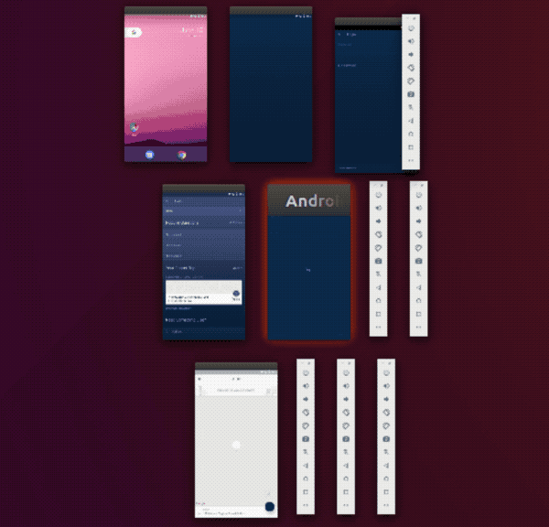
Автотесты

Slide 3

Автотесты

Slide 4
Содержание
Тестовое приложение
Lifecycle
Async
Сброс состояния на примере Orchestrator
Работа с DI
Flaky tests
What else

Slide 5
Содержание
Тестовое приложение
Lifecycle
Async
Сброс состояния на примере Orchestrator
Работа с DI
Flaky tests
What else

Slide 6
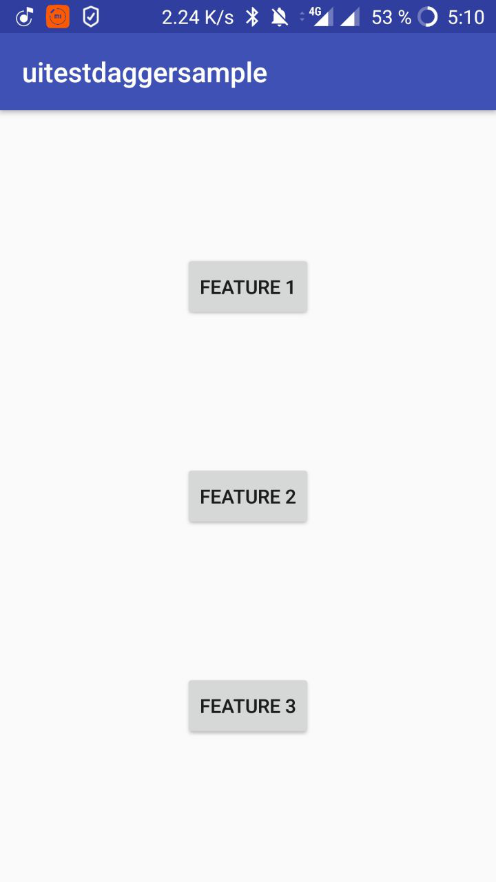
Тестовое приложение
1) 3 фичи
2 завязаны на 1 компонент
1 с прохождением FRW и инициализацией
2) Тесты на Kakao
Использован PageObject
3) Решены основные проблемы
Сброс состояния
Подмена классов
Асинхронная операция
https://github.com/v1sar/UiTestApp

Slide 7
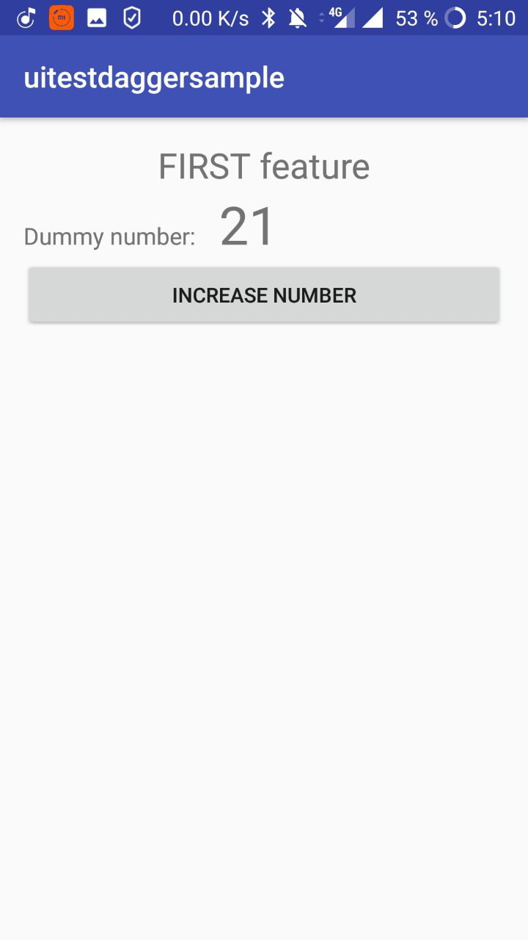
Feature 1
https://github.com/v1sar/UiTestApp

Slide 8
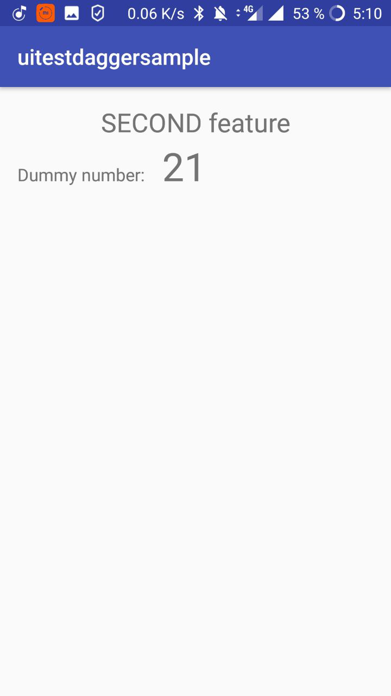
Feature 2
https://github.com/v1sar/UiTestApp

Slide 9
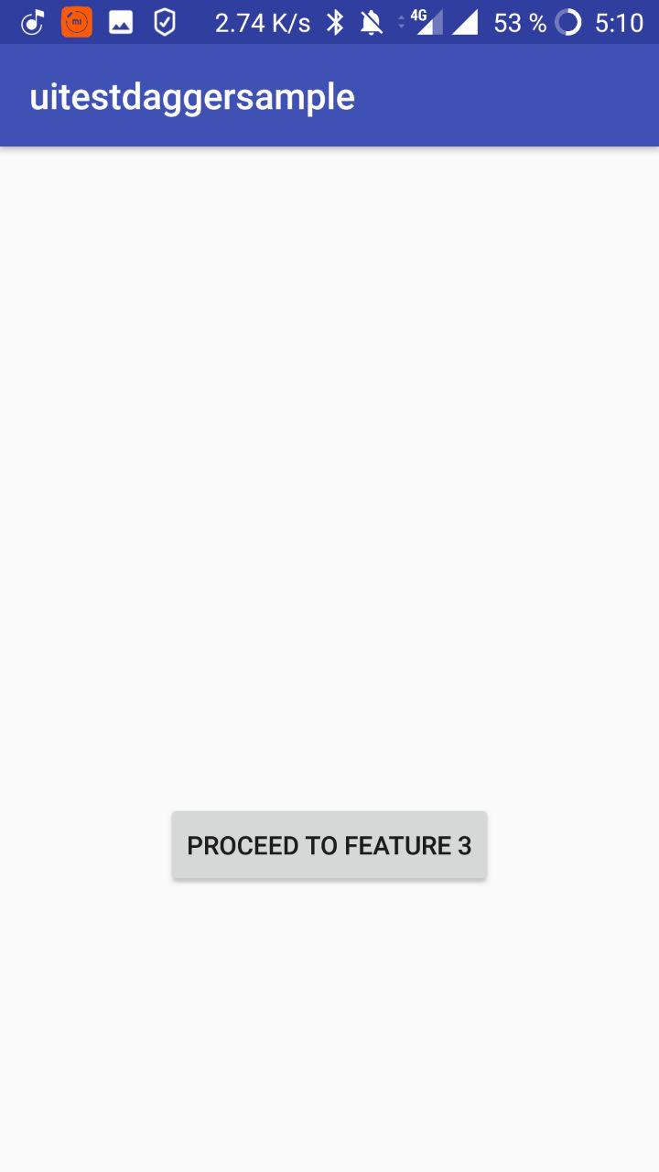
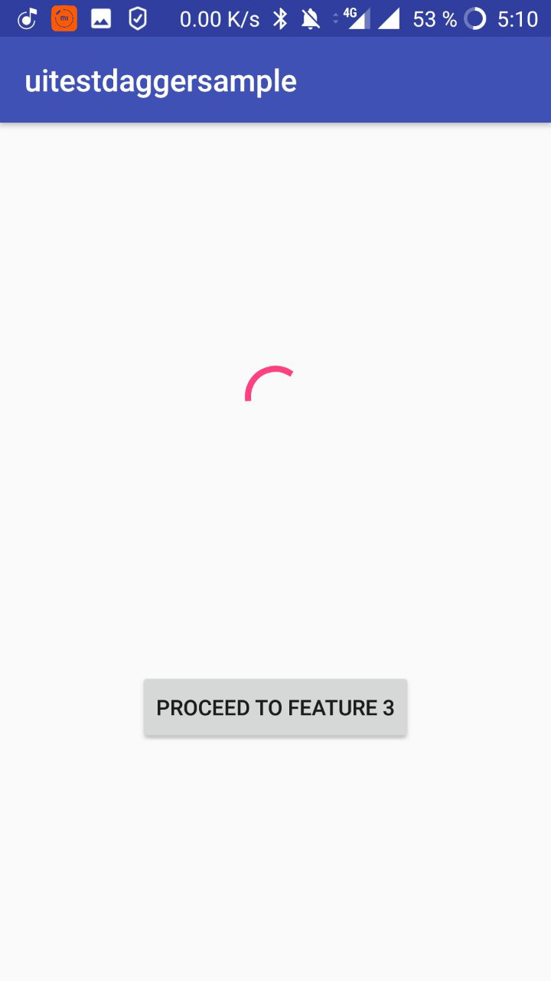
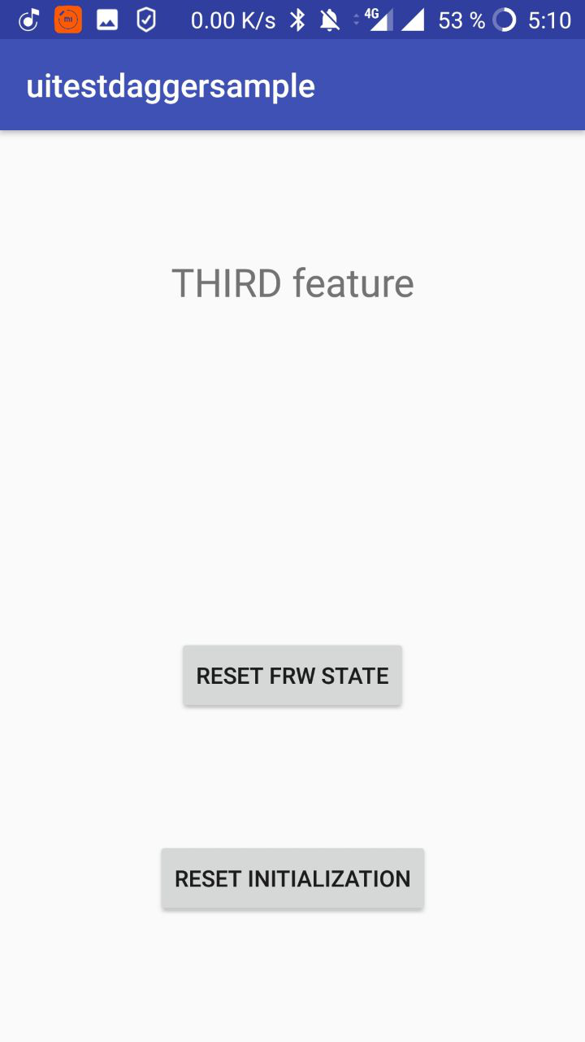
Feature 3
https://github.com/v1sar/UiTestApp

Slide 10
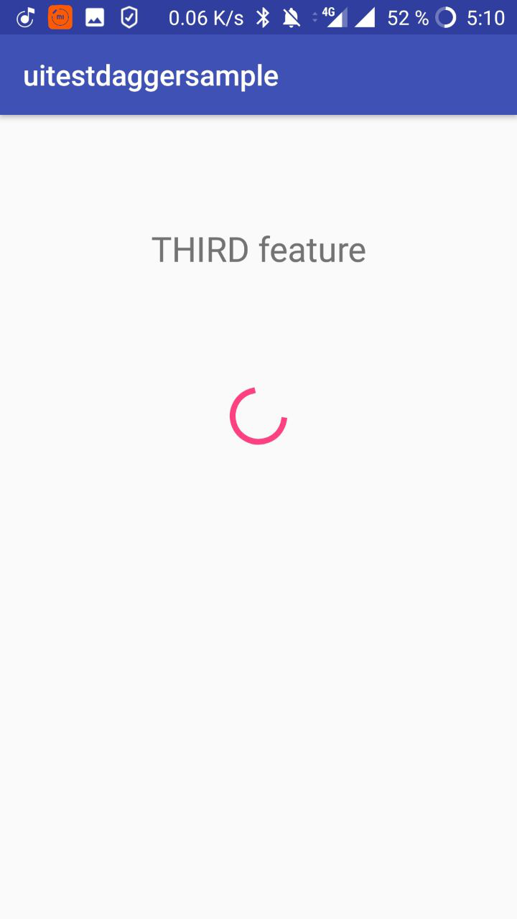
Feature 3
https://github.com/v1sar/UiTestApp

Slide 11
Содержание
Тестовое приложение
Lifecycle
Async
Сброс состояния на примере Orchestrator
Работа с DI
Flaky tests
What else

Slide 12
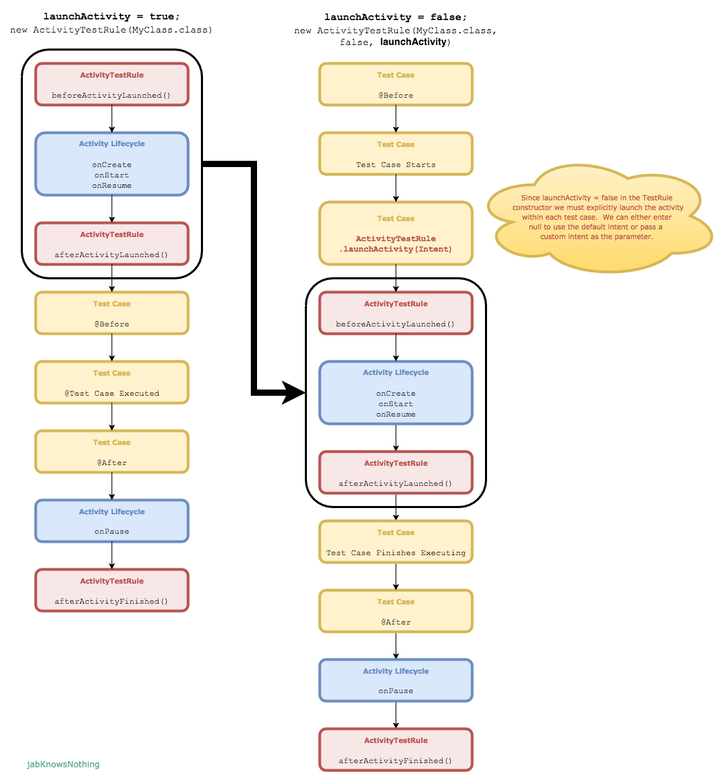
Lifecycle
Из статьи -

Slide 13
Lifecycle
3 теста, просто запускают каждую активити фичи
1
13:53:33.729 W/UiTestApplication: UiTestApplication onCreate()
13:53:33.835 W/MainActivity: MainActivity onCreate()
13:53:34.016 W/TestButtonsMainActivity: testFirstFeature
13:53:34.110 W/FirstFeature: FirstFeature onCreate()
13:53:37.103 W/MainActivity: MainActivity onCreate()
13:53:37.205 W/TestButtonsMainActivity: testSecondFeature
13:53:37.291 W/SecondFeature: SecondFeature onCreate()
13:53:38.464 W/MainActivity: MainActivity onCreate()
13:53:38.672 W/TestButtonsMainActivity: testThirdFeature
13:53:38.867 W/ThirdFeature: ThirdFeature onCreate()
2
3
~5 секунд

Slide 14
Lifecycle with Orchestrator
~8 секунд
3 теста, каждый тест жмет на кнопку фичи с MainActivity
1
14:04:40.508 W/UiTestApplication: UiTestApplication onCreate()
14:04:40.685 W/MainActivity: MainActivity onCreate()
14:04:40.925 W/TestButtonsMainActivity: testFirstFeature
14:04:41.031 W/FirstFeature: FirstFeature onCreate()
14:04:43.728 W/UiTestApplication: UiTestApplication onCreate()
14:04:43.959 W/MainActivity: MainActivity onCreate()
14:04:44.137 W/TestButtonsMainActivity: testSecondFeature
14:04:44.302 W/SecondFeature: SecondFeature onCreate()
14:04:48.345 W/UiTestApplication: UiTestApplication onCreate()
14:04:48.507 W/MainActivity: MainActivity onCreate()
14:04:48.739 W/TestButtonsMainActivity: testThirdFeature
14:04:48.918 W/ThirdFeature: ThirdFeature onCreate()
2
3

Slide 15
Содержание
Тестовое приложение
Lifecycle
Async
Сброс состояния на примере Orchestrator
Работа с DI
Flaky tests
What else

Slide 16
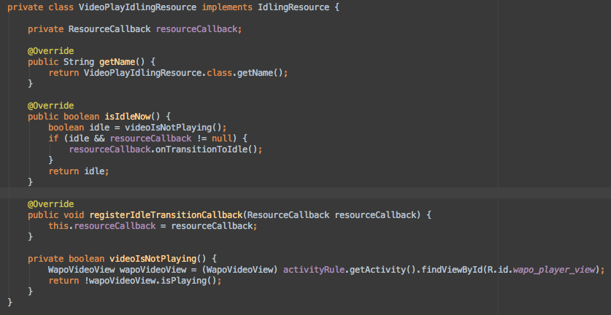
IdlingResource

Slide 17
Try/catch way
fun KButton.clickWithWait() { var bool = true while (bool) { try { click() bool = false } catch (e: Exception) { Screen<HelperScreen>().idle(200) } } }

Slide 18
Содержание
Тестовое приложение
Lifecycle
Async
Сброс состояния на примере Orchestrator
Работа с DI
Flaky tests
What else

Slide 19
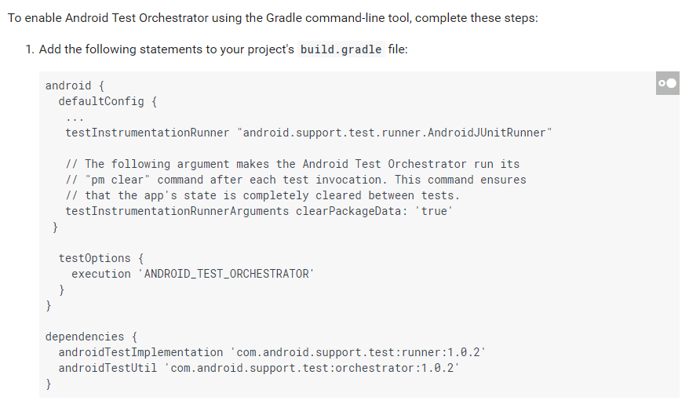
Orchestrator
Minimal shared state.
Each test runs in its own
Instrumentation instance.
Crashes are isolated.
Even if one test crashes,
it takes down only its own
instance of Instrumentation,
so the other tests in your
suite still run.
https://developer.android.com/training/testing/junit-runner

Slide 20
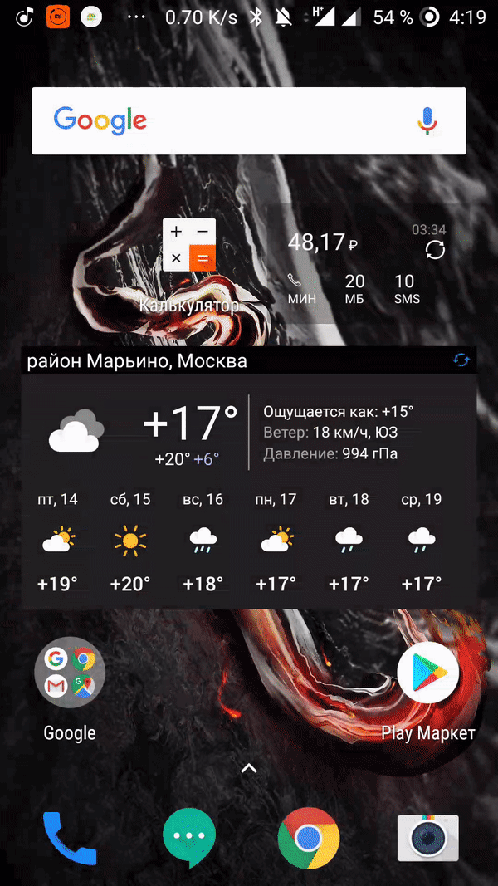
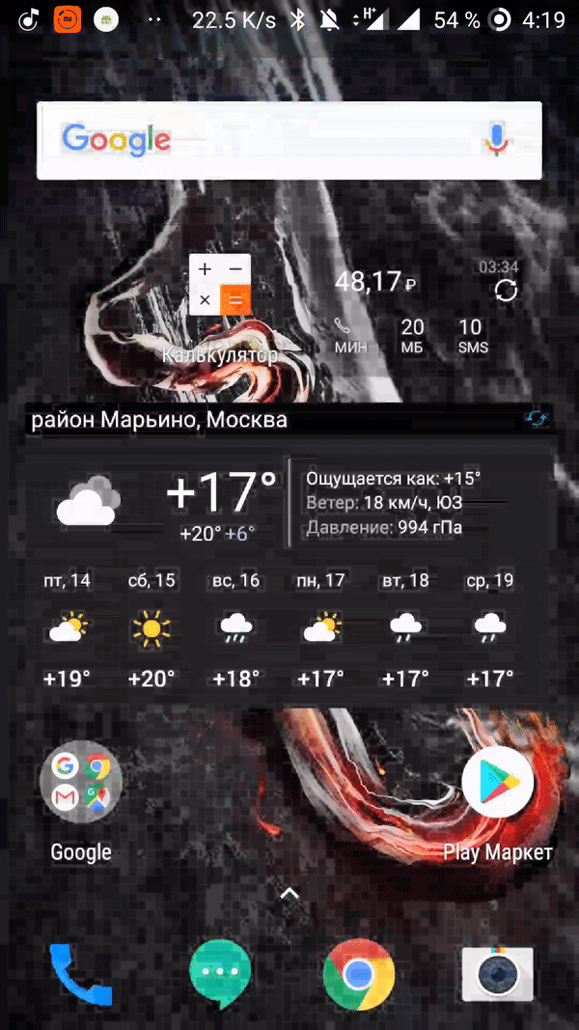
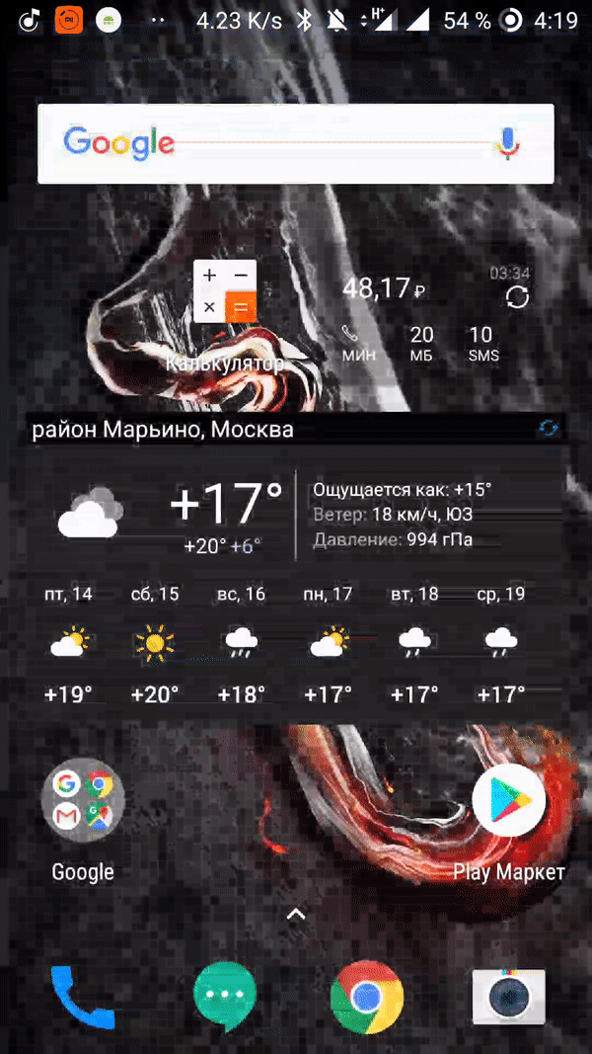
Сброс состояния

Slide 21
Содержание
Тестовое приложение
Lifecycle
Async
Сброс состояния на примере Orchestrator
Работа с DI
Flaky tests
What else

Slide 22
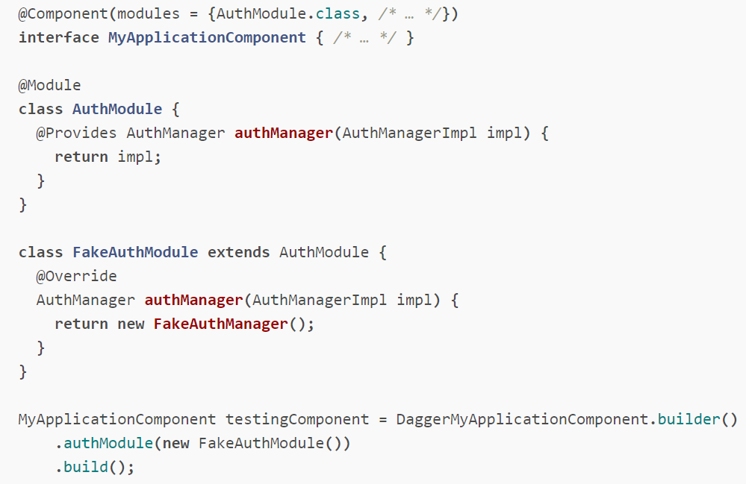
Dagger
Option 1: Override bindings
by subclassing modules
https://google.github.io/dagger/testing.html

Slide 23
Dagger
Option 1: Override bindings
by subclassing modules
(don’t do this!)
https://google.github.io/dagger/testing.html

Slide 24
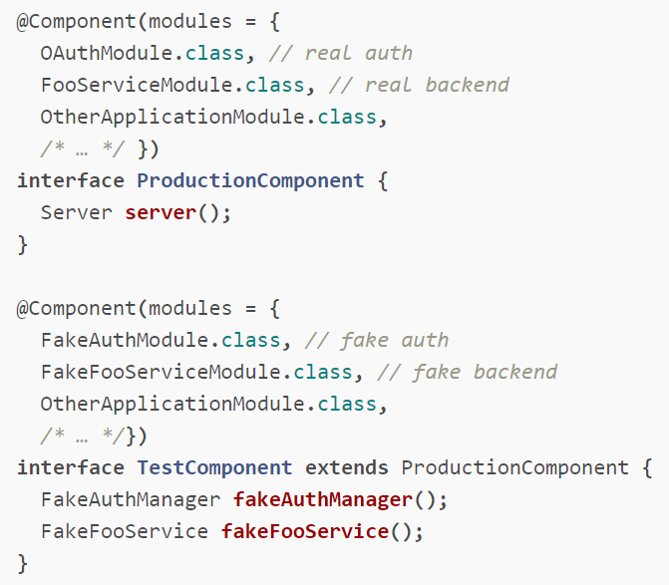
Dagger
Option 2: Separate
component configurations
https://google.github.io/dagger/testing.html

Slide 25
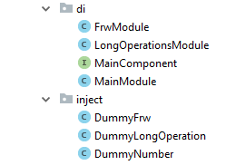
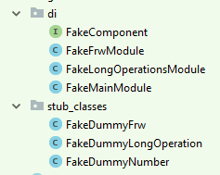
Dagger in Test App
@Before fun init() { mComponent = DaggerFakeComponent.builder() .fakeMainModule(FakeMainModule(getApp())).build() getApp().mainComponent = mComponent mComponent.inject(this) }

Slide 26
Dagger in Test App
public class DummyLongOperation { private boolean isInitialized; public Completable doLongOperation() { return Completable.timer(5, TimeUnit.SECONDS, AndroidSchedulers.mainThread()) .andThen(Completable.fromAction(() -> isInitialized = true)); } public boolean isInitialized() { return isInitialized; } public void setInitialized(boolean initialized) { isInitialized = initialized; } }
public class DummyFrw { private boolean isFrwFinished; public boolean isFrwFinished() { return isFrwFinished; } public void setFrwFinished(boolean frwFinished) { isFrwFinished = frwFinished; } }
public class DummyNumber { private static final String NUMBER_STORAGE = "number_storage"; private static final String DUMMY_NUBMER = "number_storage"; private SharedPreferences mSettings; public DummyNumber(Context context) { mSettings = context.getSharedPreferences(NUMBER_STORAGE, Context.MODE_PRIVATE); } public Integer getSomeNumber() { return mSettings.getInt(DUMMY_NUBMER, 0); } @SuppressLint("ApplySharedPref") public void setSomeNumber(int number) { mSettings.edit() .putInt(DUMMY_NUBMER, number) .commit(); } }

Slide 27
Dagger in Test App
public class FakeDummyLongOperation extends DummyLongOperation { @Override public Completable doLongOperation() { return Completable.complete(); } @Override public boolean isInitialized() { return true; } }
public class FakeDummyFrw extends DummyFrw { private boolean isFrwFinished; @Override public boolean isFrwFinished() { return isFrwFinished; } @Override public void setFrwFinished(boolean frwFinished) { isFrwFinished = frwFinished; } }
public class FakeDummyNumber extends DummyNumber { public FakeDummyNumber(Context context) { super(context); } @Override public Integer getSomeNumber() { return 1000; } @Override public void setSomeNumber(int number) { } }

Slide 28
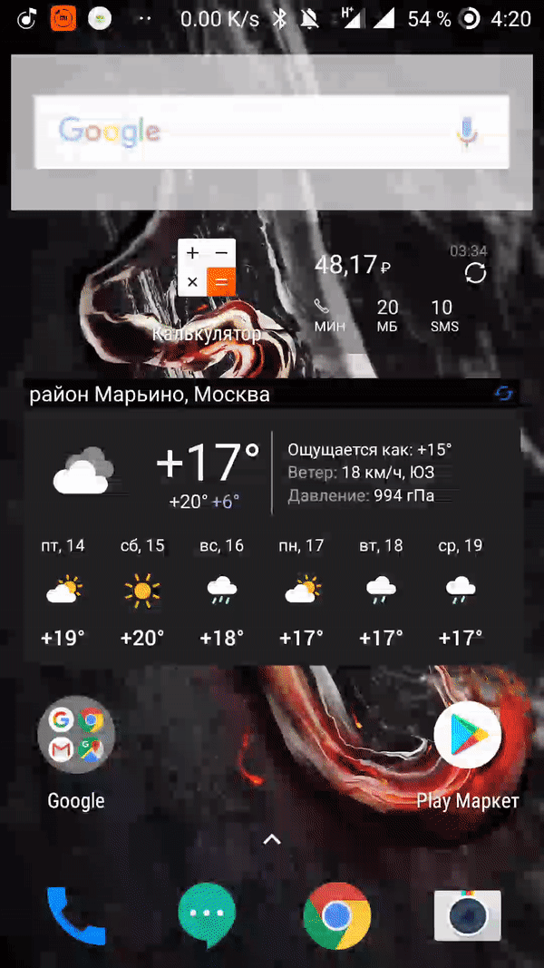
Dagger in tests | Feature 1
e2e
Integration
@Test fun testFirstFeature() { mMainScreen { toFirstFeatureButton { isVisible() click() } } mFirstFeatureScreen { dummyNumber { hasAnyText() } dummyNumberButton { click() click() click() click() click() } } }
@Test fun testFirstFeatureWithMocks() { rule.launchActivity(null) mMainActivityScreen { toFirstFeatureButton { click() } } mFirstFeatureScreen { dummyNumberButton { click() click() click() click() click() } } }

Slide 29

Dagger in tests | Feature 3 | mock initialization
e2e
Integration
@Test fun testThirdFeature() { mMainScreen { toThirdFeatureButton { isVisible() click() } } mThirdFeatureFrwScreen { proceedButton { click() } } mThirdFeatureScreen { featureDisclaimer { isVisibleWithWait() } } }
@Test fun testThirdFeatureWithFakeInitializationDone() { rule.launchActivity(null) mMainActivityScreen { toThirdFeatureButton { click() } } mThirdFeatureFrwScreen { proceedButton { click() } } mThirdFeatureScreen { featureDisclaimer { isVisible() } } }

Slide 30
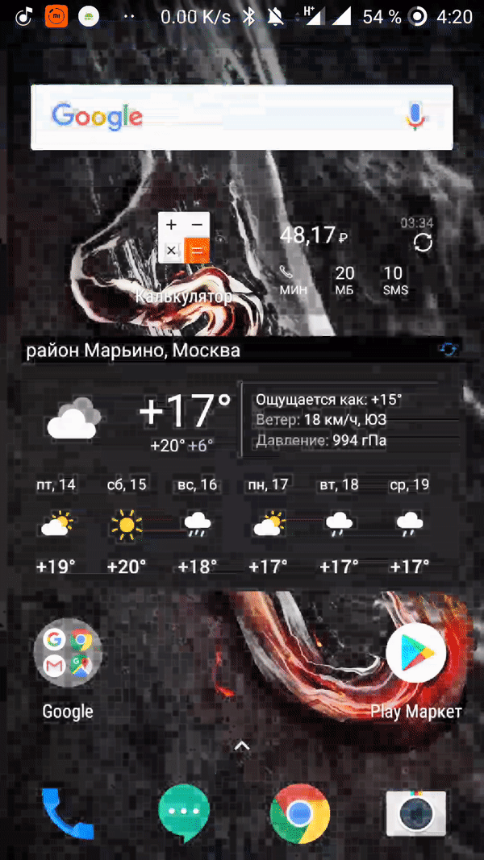
Dagger in tests | Feature 3 | mock initialization & FRW
e2e
Integration
@Inject lateinit var mFakeDummyFrw: DummyFrw
@Test fun testThirdFeature() { mMainScreen { toThirdFeatureButton { isVisible() click() } } mThirdFeatureFrwScreen { proceedButton { click() } } mThirdFeatureScreen { featureDisclaimer { isVisibleWithWait() } } }
@Test fun testThirdFeatureWithFrwDone() { rule.launchActivity(null) mFakeDummyFrw.isFrwFinished = true mMainActivityScreen { toThirdFeatureButton { click() } } mThirdFeatureScreen { featureDisclaimer { isVisible() } } }

Slide 31
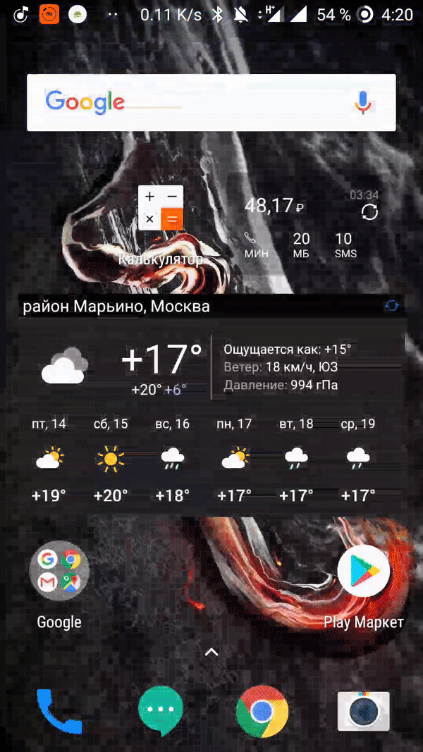
Dagger in tests | Feature 3 | mock initialization & FRW + start from Feature 3
@Rule @JvmField val ruleThirdFeature = ActivityTestRule(ThirdFeature::class.java, false, false)
@Inject lateinit var mFakeDummyFrw: DummyFrw
@Test fun testThirdFeatureWithFrwDone() { rule.launchActivity(null) mFakeDummyFrw.isFrwFinished = true mMainActivityScreen { toThirdFeatureButton { click() } } mThirdFeatureScreen { featureDisclaimer { isVisible() } } }
@Test fun testThirdFeatureWithFrwDoneWithoutMainActivity() { mFakeDummyFrw.isFrwFinished = true ruleThirdFeature.launchActivity(null) mThirdFeatureScreen { featureDisclaimer { isVisible() } } }

Slide 32
Содержание
Тестовое приложение
Lifecycle
Async
Сброс состояния на примере Orchestrator
Работа с DI
Flaky tests
What else

Slide 33

Flaky tests

Slide 34
Flaky test
Есть 2 вида таких тестов
Мы должны перепроверять тест несколько раз, чтобы убедиться что он всегда проходит.
Мы должны перепроверять тест несколько раз, пока он не будет хотя бы один раз пройден, даже если он упадет во время одной из попыток.

Slide 35
Flaky test
private ActivityTestRule<FlakyActivity> activityRule = new ActivityTestRule<>(FlakyActivity.class); private FlakyTestRule flakyRule = new FlakyTestRule(); @Rule public RuleChain chain = RuleChain.outerRule(flakyRule) .around(activityRule); // Use @AllowFlaky to let flaky tests pass if they pass any time. @Test @AllowFlaky(attempts = 5) public void some_flaky_test() throws Exception { // ... } // Use @Repeat to avoid flaky tests from passing if any repetition fails. @Test @Repeat(times = 5) public void some_important_test() throws Exception { // ... }
https://github.com/SchibstedSpain/Barista

Slide 36
Содержание
Тестовое приложение
Lifecycle
Async
Сброс состояния на примере Orchestrator
Работа с DI
Flaky tests
What else

Slide 37
Шортлист «проблемы KIS`ы»
Инициализация в PermissionsActivity
Свое хранилище стейта

Slide 38
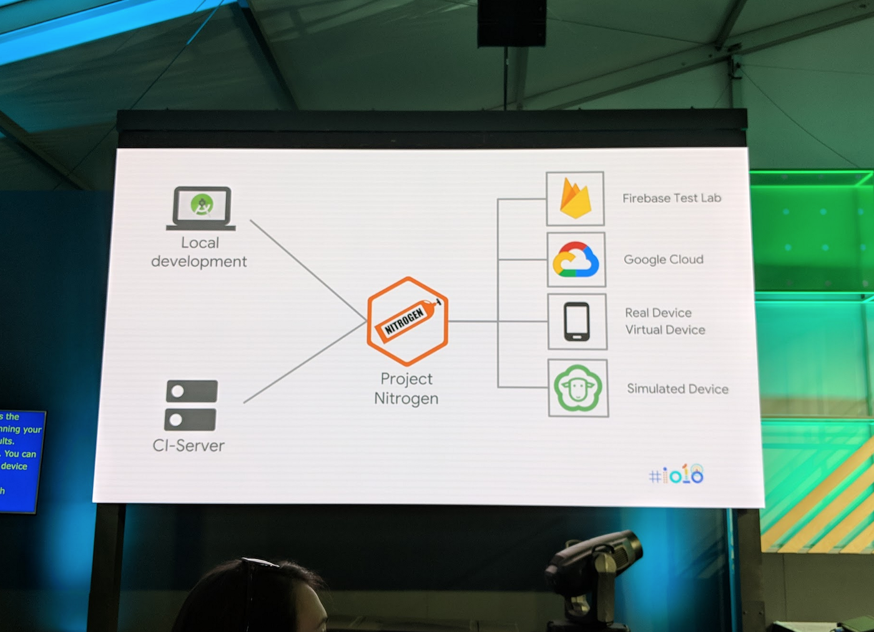
Espresso in JVM
https://www.youtube.com/watch?v=wYMIadv9iF8
https://proandroiddev.com/robolectric-testing-with-androidjunitrunner-86292bceef25

Slide 39
Выводы
Для начала написания UI тестов нужно:
Посмотреть данную презентацию
Посмотреть написанное приложение
….
3.Начинать пилить авто-тесты у себя.
https://github.com/v1sar/UiTestApp

Slide 40

Let’s Talk?
Kaspersky Lab HQ
39A/3 Leningradskoe Shosse
Moscow, 125212, Russian Federation
Tel: +7 (495) 797-8700
www.kaspersky.com

